Slide 1

Test Automation

Slide 2
1. Automation Testing

Slide 3
What is Automation Test?

Slide 4
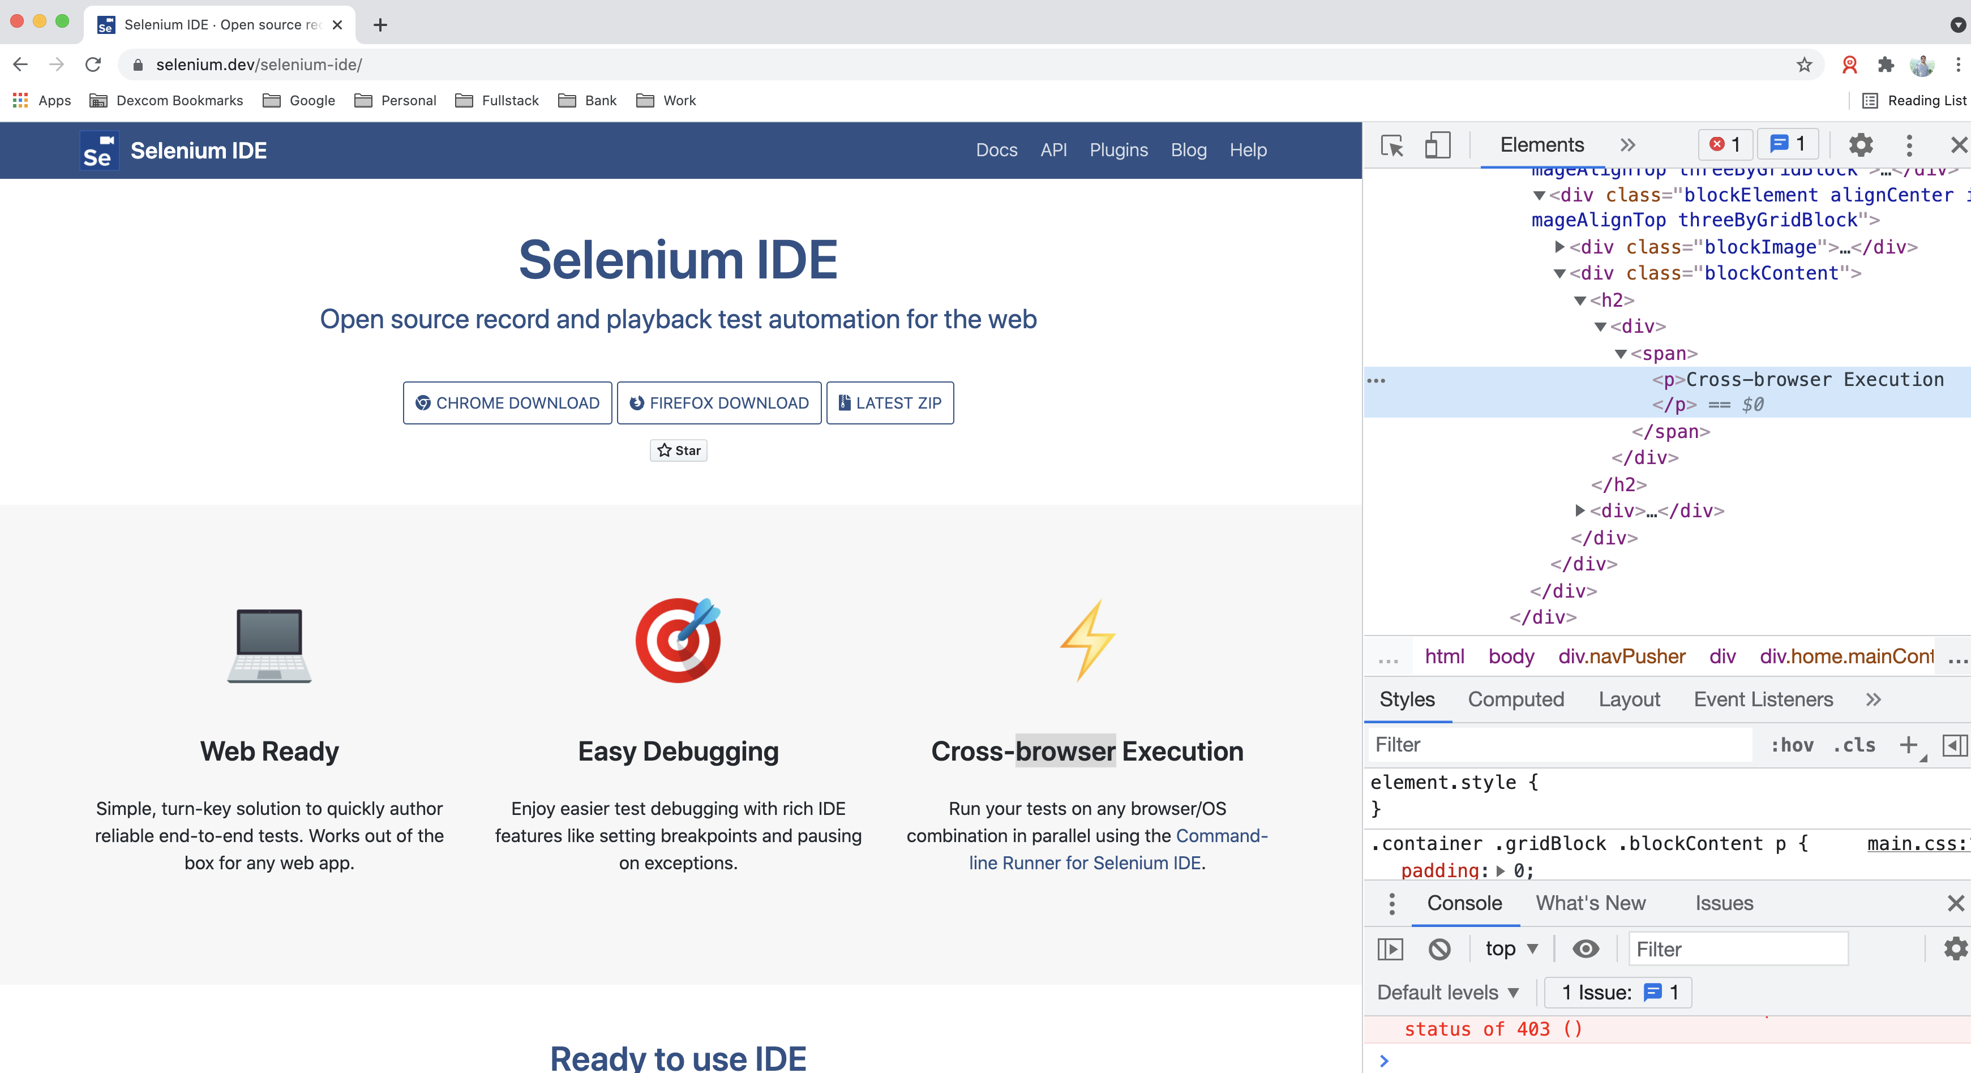
What is Automation Test?
Automation Test
Test automation is many things, we will define test automation as the automatic execution of functional tests, designed at least in some ways to simulate a human being executing manual tests.

Slide 5
Advantages and disadvantages of Automation Test?
Advantages
Performing some tests that cannot be performed at all (or easily) manually
Reducing the time needed for test execution
Increasing the frequency that some tests can be run
Reducing mistakes made by bored or distracted manual testers
Executing tests outside of normal business hours
Increasing confidence in the build
Disadvantages
Delays, costs, and mistakes associated with testers as they learn new technologies
In worst cases, complexity may become overwhelming
Considerable maintenance of tools, environments, and test assets required
The pesticide paradox is increased when automation is used since exactly the same test is run each time
Without clever programming in the automated tests, tools are literal minded and stupid;testers are not

Slide 6
Web Testing vs. Mobile Testing

Slide 7
Web Testing vs. Mobile Testing
Web Testing
A web application (app) is a program delivered through the internet in the form of a browser interface. Web app testing, or web testing, is a software testing practice that helps ensure the quality and functionalities of the app according to the requirements.
There are many types of Testing Techniques that can be applied to Web Testing:
Functionality Testing
Interface Testing
Compatibility Testing
Performance Testing

Slide 8
Web Testing vs. Mobile Testing
How to Test Web Apps
There are a few things that need to be tested when you’re checking the app behavior:
Test all links in your webpages are working correctly and make sure there are no broken links.
Test Forms are working as expected
Test Cookies are working as expected.
Test HTML and CSS.
Test business workflow.

Slide 9
Web Testing vs. Mobile Testing
Mobile Testing
There are three main types of mobile application:
Native: They are downloaded, installed and updated from supplier stores. These apps may need testing on all supported devices
Browser-based: These are accessed through a mobile browser and they use the typical web-development technologies and browsers,
Hybrid: Hybrid applications are a combination of native app and web app.

Slide 10
Web Testing vs. Mobile Testing
How to Test Mobile Apps?
We need to consider the following specific risks and challenges
The variety of mobile devices with device-specific defects on some of them.
The availability of devices in-house or via the use of external test labs.
The introduction of new technologies, devices and/or platforms during the application life cycle.
The installation and upgrade of the app itself via various channels, including preserving app data and preferences.
The ability to test using the networks of various service providers.
The use of mobile emulators, simulators and/or real devices for specific test levels and types of test

Slide 11
Exploring Web Elements

Slide 12
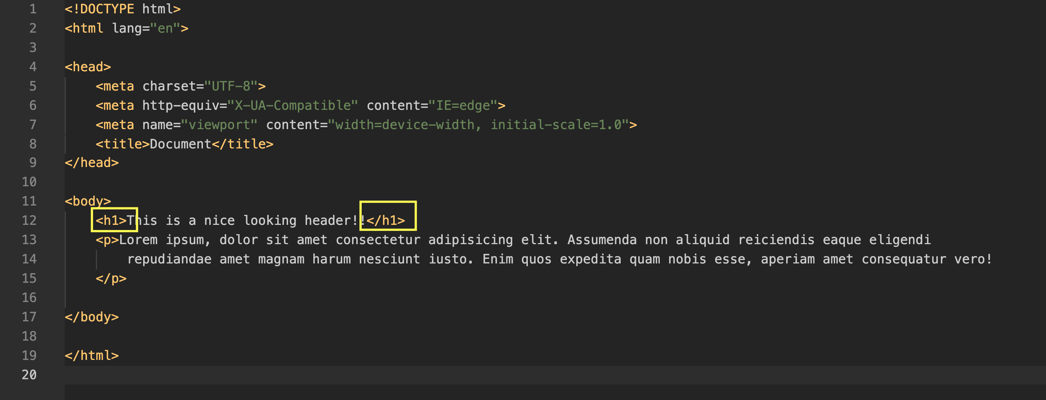
Exploring Web Elements
What’s HTML?
An HTML document is a plain text file which contains elements which specify certain contextual meanings when the document is parsed. HTML describes the structure of a web page semantically and the most important benefit to using HTML is the universal applicability of the language.
HTML elements are introduced and often surrounded by tags which are defined by angle brackets as seen below:

Slide 13
Exploring Web Elements
What’s HTML ?
An HTML document is a plain text file which contains elements which specify certain contextual meanings when the document is parsed. HTML describes the structure of a web page semantically and the most important benefit to using HTML is the universal applicability of the language.
HTML elements are introduced and often surrounded by tags which are defined by angle brackets as seen below:

Slide 14
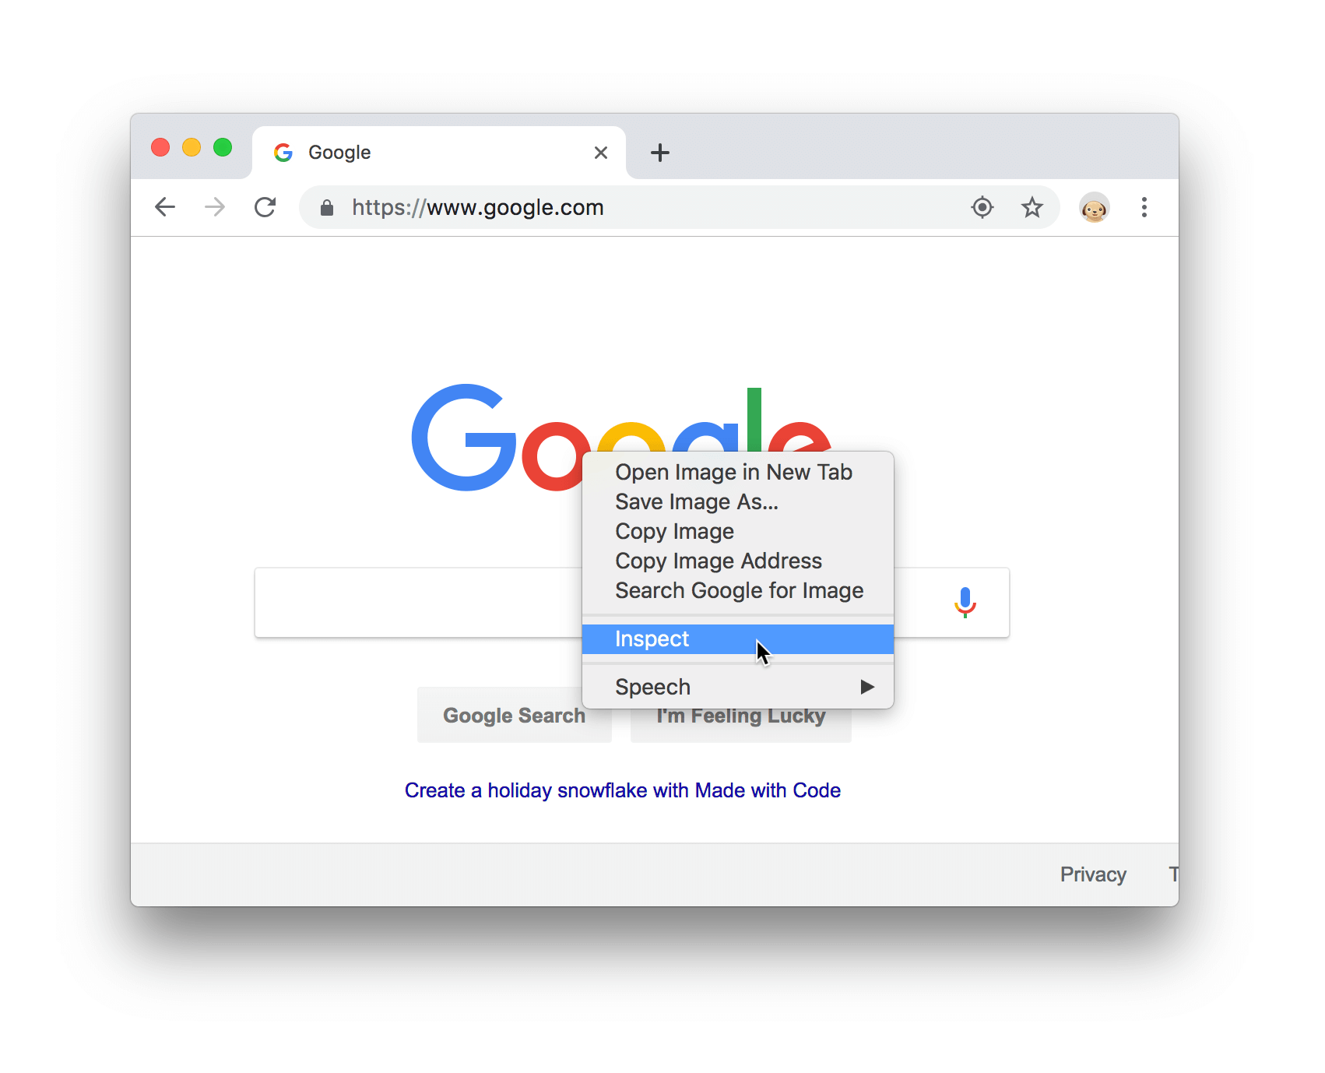
Exploring Web Elements
Click Customize and control Google Chrome and then select More Tools > Developer Tools.
Chrome Inspector:
Chrome DevTools is a set of web developer tools built directly into the Google Chrome browser.
Click Customize and then select More Tools > Developer Tools.
Right-click the element and select Inspect.

Slide 15
2. Selenium

Slide 16
Selenium Architecture and its Integration to Java

Slide 17
Selenium Architecture Components
Selenium Facts
Selenium is an Open-Source Automation Tool
It’s exclusively for Web Applications
It works with different browsers: Firefox, Chrome, Safari, Internet Explorer, Edge
Can run in different OS: Windows, Linux, Mac OS
Can use multiple programming languages: Java, C#, Python, JavaScript, Ruby

Slide 18
Selenium Architecture Components
Selenium IDE
It is an add-on to Chrome and Firefox web browsers, its main function is recording and playing back user actions on web pages; the recorded scripts can be saved to disk as HTML tables or exported to several different programming languages.
Selenium WebDriver *
It is mainly a framework allowing test scripts to control web browsers, enables test automators to combine WebDriver’s ability to control web browsers with the power of general programming languages.

Slide 19
Selenium Architecture Components
Selenium Grid
It enables running test scripts across multiple machines with different configurations. It allows distributed and simultaneous execution of test cases. It can be configured to use many physical or virtual machines with different combinations of operating systems and versions of web browsers.
Selenium Standalone Server
This tool is written in Java and is delivered as a jar file that implements hubs and nodes functions for Selenium Grid. This tool needs to be started separately (outside of test scripts) and configured properly to play its role in test environment.

Slide 20
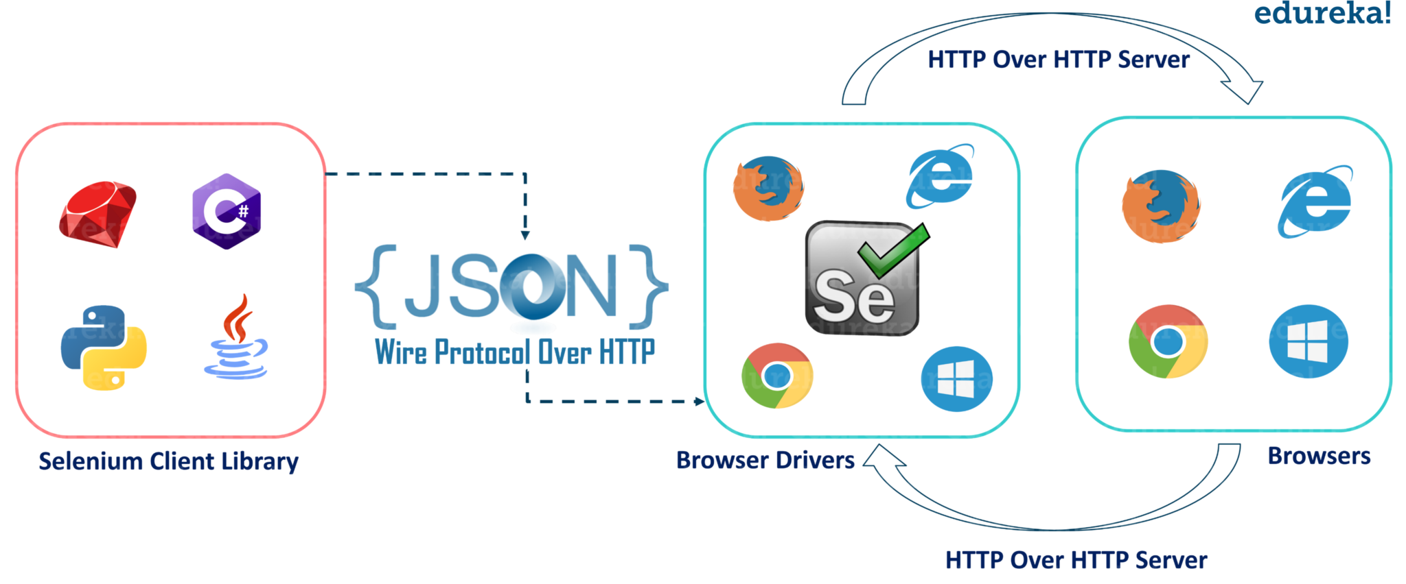
Selenium Architecture Components
Selenium Behavior Explanation

Slide 21
How to integrate to Java?
How Selenium and Java Work together?
Verify if Java is installed in your computer
Install Java if not installed before
Set Environment Variables: JAVA_HOME & Path
Install IDE(IntelliJ) and create test cases (Java Project & Class files)
Install Selenium (.jar files)

Slide 22
Locators

Slide 23
Locators
What is a locator?
To perform most operations with WebDriver, you will need to locate the UI elements on which you want to operate in the currently active screen. This can be accomplished by using the find_element_ or find_elements_ methods within WebDriver.
Elements can be found by several different locators:
by_id (id_)
by_class_name (name)
by_name (name)
By_linkText (linkText)
by_xpath (xpath)
by_css_selector (css_selector)

Slide 24
Locators
By ID (Exercise 4)
Efficient
By definition, each ID should be unique in the HTML document
A tester can add IDs to the SUT easily
By Link Text (Exercise 4)
If the link text is unique to a page, you can find the element
The link text is visible to the user (in most cases), so it's easy to know what the test code is looking for
Partial link text is slightly less likely than the full link text to change

Slide 25
Locators
By XPath:
You can find elements that don't have any unique attributes (id, class, name, etc.)
You can use XPath in generic locators, using the different "By" strategies (by id, by class, etc.) as needed
By Class Name:
Class names can be used multiple places in the DOM, but you can limit the locating to the loaded page (for example on a popup modal dialog)
A tester can add class names to the SUT easily
Selenium does not accept class name with spaces

Slide 26
4. Web Automation

Slide 27
5. Verifications and Assertions

Slide 28
6. Appium

Slide 29
Appium Features
Some things you should know about Appium:
Appium is an open-source Automation tool
It supports multiple platforms for Automation (Android, iOS)
Can work with Native, Hybrid and Mobile Web Apps
It shares a lot of common functionalities with Selenium
Can be written in multiple languages (Java, Phyton, etc.)
It requires an Appium Server to work (Node.js)

Slide 30
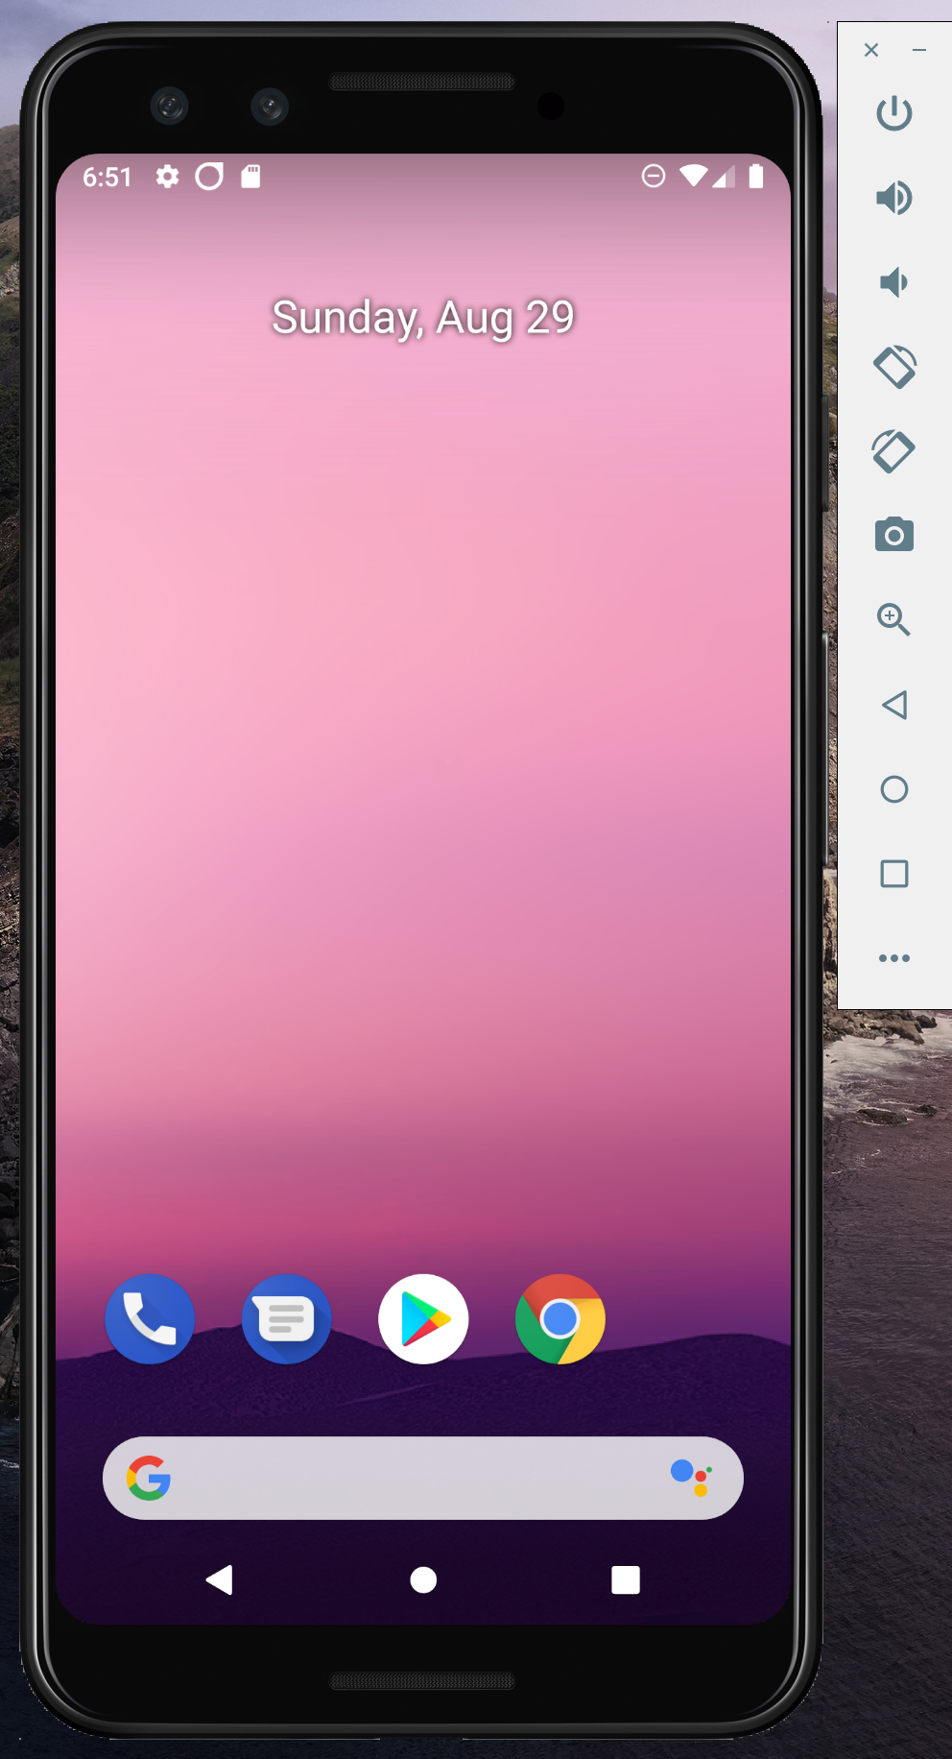
Setup Android Emulator
Let's setup Android Emulator with Android Studio
AVD Manager

Slide 31
Desired Capabilities
What are desired capabilities?
Desired Capabilities are just a set of keys and values that get sent to the Appium server during session initialization, that tell Appium what kind of thing we want to automate. The minimum set of required capabilities for any Appium driver should include:
platformName: the name of the platform to automate
platformVersion: the version of the platform to automate
deviceName: the kind of device to automate
app: the path to the app you want to automate (but use the browserName capability instead in the case of automating a web browser)
automationName: the name of the driver you wish to use

Slide 32
Appium Exercise 1
Launch the App in your Virtual Device

Slide 33
Appium Exercise 2
Use UIAutomatorViewer to inspect objects and build your first script with XPath and Text

Slide 34
Appium Exercise 3
Gestures in Automation (TouchActions)

